Slide 1
Should I Stay or Should I Go?
A statistical analysis comparing NFL quarterbacks that played 4 years of college football to NFL quarterbacks that played 3 years of college football.

Slide 2
Introduction
Every year many draft eligible quarterbacks have to make the tough decision of either declaring for the NFL draft or staying in school.
-Every April NFL teams have to make the debatably tougher decisions of which players to draft.
-If staying in school an extra year contributes to a better NFL career then underclassmen in the draft should be considered riskier selections for NFL teams.

Slide 3
Background Information
-The players we used in our study include all NFL quarterbacks drafted in the first three rounds in the past 20 years. We also took out any quarterbacks that had played in fewer than 20 games.

Slide 4
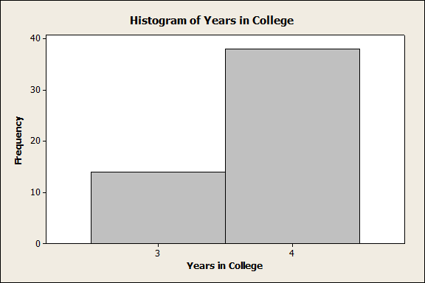
As you can see, quarterbacks drafted in the first three rounds over the last 20 years have mostly been college seniors. The exact numbers were 14 underclassmen and 38 seniors.

Slide 5
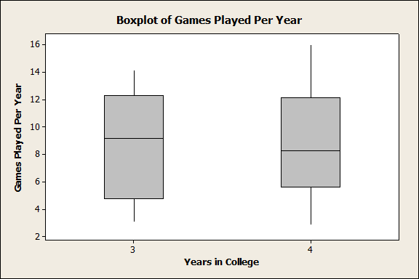
-Quarterbacks that entered the draft after 3 years of college played in a median of 9.14 games per year with an IQR of 7.53, a standard deviation of 3.8, a min of 3.06, and a max of 14.14.
-Quarterbacks that stayed in college for all 4 years played in a median of 8.27 games per year with an IQR of 6.52, a standard deviation of 3.857, a min of 2.875, and a max of 16.

Slide 6
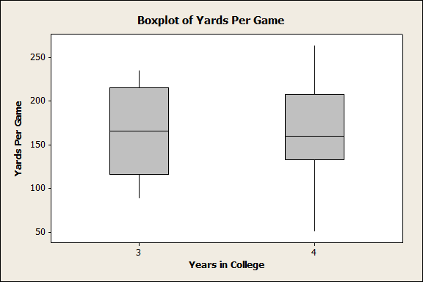
-Quarterbacks that entered the draft after 3 years of college threw for a median of 165.25 yards per game, with an IQR of 98.8, a standard deviation of 49.7, a min of 87.9, and a max of 235.6.
-Quarterbacks that stayed in college for all 4 years of college threw for a median of 159.65 yards per game, with an IQR of 75.25, a standard deviation of 50.23, a min of 50.6, and a max of 263.6.

Slide 7
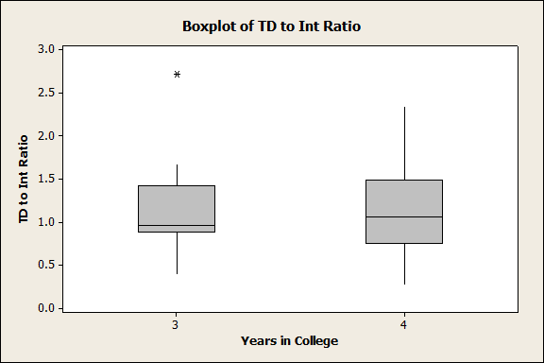
-Quarterbacks that entered the draft after 3 years of college had a median touchdown to interception ratio of .958, with an IQR of .537, a standard deviation of .561, a min of .389, and a max of 2.719.
-Quarterbacks that stayed in college for all 4 years of college had a median touchdown to interception ratio of 1.05, with an IQR of .735, a standard deviation of .488, a min of .266, and a max of 2.34.

Slide 8
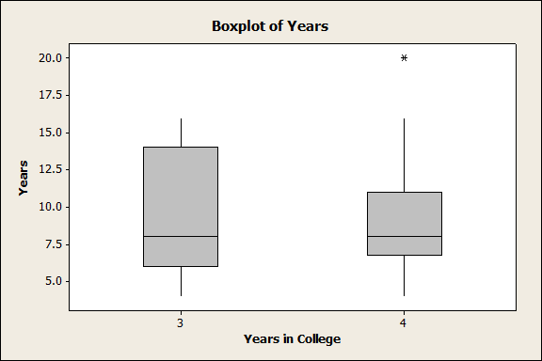
-Quarterbacks that entered the draft after 3 years of college played a median of 8 years in the NFL, with an IQR of 8, a standard deviation of 3.91, a min of 4, and a max of 16.
-Quarterbacks that stayed in college for all 4 years of college played a median of 8 years in the NFL, with an IQR of 4.25, a standard deviation of 3.324, a min of 4, and a max of 20.

Slide 9
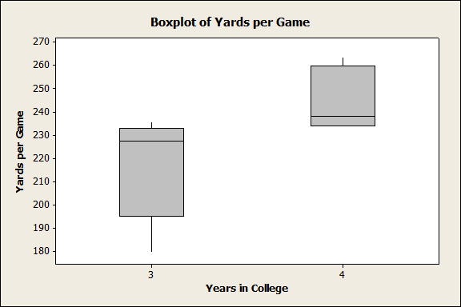
-Top 5 Quarterbacks that threw for the most yards per game that entered the draft after 3 years of college threw for a median of 227.3 yards per game, with an IQR of 37.7, a standard deviation of 22.7, a min of 179.5, and a max of 235.6.
-Top 5 Quarterbacks that threw for the most yards per game that stayed in college for all 4 years of college threw for a median of 237.9 yards per game, with an IQR of 25.55, a standard deviation of 13.68, a min of 234, and a max of 263.6.

Slide 10
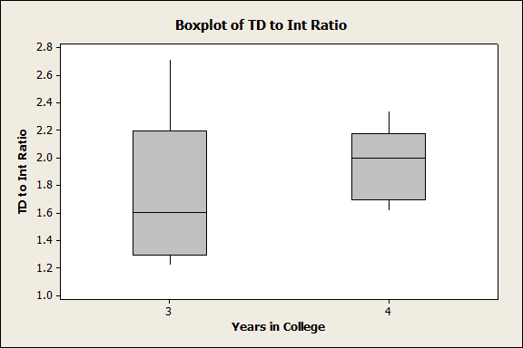
-The Top 5 Quarterbacks that have the highest TD to Int Ratio and entered the draft after 3 years of college had a median touchdown to interception ratio of 1.603., with an IQR of .906, a standard deviation of .590, a min of 1.218, and a max of 2.719.
-The top 5 Quarterbacks that have the highest TD to Int Ratio and that stayed in college for all 4 years of college had a median touchdown to interception ratio of 2, with an IQR of .482, a standard deviation of .275, a min of 1.698, and a max of 2.34.

Slide 11
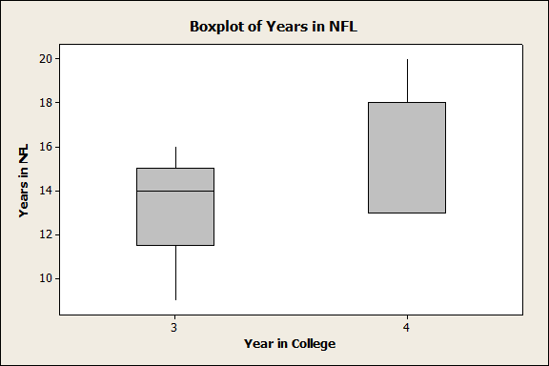
- The top 5 Quarterbacks that entered the draft after 3 years of college in years played in the NFL played a median of 14 years in the NFL, with an IQR of 4.5, a standard deviation of 2.61, a min of 9, and a max of 16.
-The top 5 Quarterbacks that stayed in college for all 4 years of college in years played in the NFL played a median of 13 years in the NFL, with an IQR of 5, a standard deviation of 3.08, a min of 13, and a max of 20.

Slide 12
Conclusion
Our conclusion is that in general it does not seem to matter if a Quarterback stays for 3 years of college, or if he stays for 4 years. However, when we took the top 5 of each category we found that players that stayed for 4 years of college seem to be more likely to become an elite player in the N.F.L. than players that stayed for only 3 years.

